Slide 1
MLaaS using
Homomorphic
Encryption
Dost Arora - 1RV16IS015
Jibran Mukhtar – 1RV16IS018

Slide 2


Basic Communication
Data Transfer
But, we need to protect our Data, that we are transferring
Notes:
This is the basic model of a client talking to cloud
*CLICK*
We need to protect our Data, from various adversaries that are trying to snoop
*NEXT SLIDE*

Slide 3


Threat Model 1
Data Transfer
Solution : Encrypt the channel
Notes:
*CLICK*
We’ve got someone SNOOPING ON us!!.
*CLICK*
Therefore we’ve got to encrypt the communication channel with the server
*NEXT SLIDE*

Slide 4
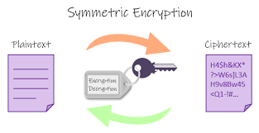
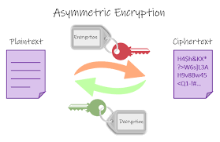
Solution : Encryption
Notes:
The explanation of Symmetric & Asymmetric is that…*EXPLAIN*
*NEXT SLIDE*

Slide 5


TLS
Transport Layer Security
One small problem ...
Notes:
*CLICK*
TLS provides secure transfer of data between client and cloud
Our communication channel is now secure
*CLICK*
But this has not completely solved our problem
Since the attackers & organisations will employ other methods... *NEXT SLIDE*

Slide 6

So now what ...

Slide 7

Threat Model 2
The adversaries have now the access to the cloud service as well.
Notes:
*CLICK*
The adversaries have now the access to the cloud service as well.
The solution for now is to encrypt the file itself, and send the encrypted file to cloud
*NEXT SLIDE*

Slide 8

Solution : Local Encryption
Data is now secure
But cloud can’t do any modifications
We have to pull it to our local system, to perform analysis on it.
Notes:
Cloud Does NOT have access to our data

Slide 9
Using the Data
Download the data
Decrypt the file
Modify the file
Re -encrypt the file
Upload the file

Slide 10
What do we want ...
Encrypted data
Can be read only by us
Can be modified by Cloud server
Confidentiality & availability is imperative
Notes:
Here’s where Homomorphic Encryption comes in, but what exactly does Homomorphism mean?

Slide 11
Homomorphism ...
Pick a DOMAIN and OPERATION :
Define a FUNCTION :
Check :
F (X * Y) = F( X ) * F( Y )
( R, * )
F ( X ) = | X |
| X * Y | = | X | * | Y |

Slide 12
Some Examples
( R, * ) : F( X ) = 3X²
( Z, + ) : F( X ) = 3X
Interesting one ...
( Z mod P, + ) : F( X ) = X + P

Slide 13
Intuition
We want to encrypt one bit at a time.
We want E( KEY, data ) to be HOMOMORPHIC :
(Z mod 2, +) and (Z mod 2, *)
E( key, D1 + D2 ) = E( key, D1 ) + E( key, D2 )
E( key, D1 * D2 ) = E( key, D1 ) * E( key, D2 )

Slide 14
What we have ?
KeyGen()
Encrypt( key, m) - Homomorphic
Decrypt (key, c)
So what ? ...

Slide 15
An Interesting equation
A B 1+A*B
0 0 1
0 1 1
1 0 1
1 1 0
1 + A * B
Since E is homomorphic…
E ( key, 1 + A * B) =
E( key, 1 ) + E( key, A ) * E( key, B)
We have NAND gate !!

Slide 16

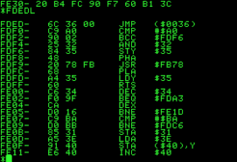
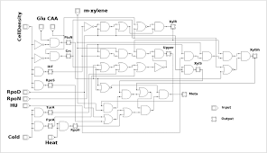
NAND to the rescue
Normal Code Logic
Machine Code
NAND Logic

Slide 17
Final Encryption
F(X) = Evaluate(key, function)
f(x)

Slide 18
Cloud: Machine Learning as a Service
Consider a hospital that would like to use a cloud service to improve the quality of care and to reduce costs.
Due to ethical and legal requirements regarding the confidentiality of patient information, the hospital might be prohibited from using such a service
We need a way by which the hospital can use this valuable service without sacrificing patient privacy
In the proposed protocol, the hospital encrypts the private information and sends it in encrypted form to cloud.
The cloud is able to compute the prediction over the encrypted data records and sends back the results that the hospital can decrypt and read

Slide 19
Literature Survey:
Paper Title | Title | Key Objectives
Secure Cloud Computing through Homomorphic Encryption | Maha TEBAA, Said EL HAJII | Analyses application of different H.E.cryptosystems (RSA, Paillier, El Gamal, Goldwasser-Micali,etc. Comparison based on four characteristics; Encryption type, Privacy, Security applied and keys used.
Security Issues in Cloud Computing: The Potentials of Homomorphic Encryption | Aderemi A. Atayero , Oluwaseyi Feyisetan | How to maintain semantic security in cloud? Decrease cloud resource consumption terms of time and memory. Indexing of encrypted data.
Privacy preserving Neural Network Inference on Encrypted Data with GPUs | Daniel Takabi, Robert Podschwadt, Jeff Druce, Curt Wu, Kevin Procopio | Demonstration of FHE-compatible CNN that is able to classify the homomorphically encrypted images. FHE can be significantly accelerated with GPUsFHE can be significantly accelerated with GPUs

Slide 20
Literature Survey:
Paper Title | Title | Key Objectives
CryptoNets: Applying Neural Networks to Encrypted Data with High Throughput and Accuracy | Nathan Dowlin, Ran Gilad-Bachrach, Kim Laine , Kristin Lauter , Michael Naehrig , and John Wernsing | Neural networks that can be applied to encrypted data. Cryptographic Neural Nets on the MNIST optical character recognition tasks.
Unsupervised Machine Learning on Encrypted Data | Angela Jaschke and Frederik Armknecht | K-Means-Algorithm, in the FHE context. Using a natural encoding of data that allows division operation.
Efficient Cloud-based Secret Shuffling via Homomorphic Encryption | Kilian Becher, Thorsten Strufe | Tackling cloud-based multi-party computation scenarios such as that of the ownership relation between data providers and their inputs. Presents a multi-party protocol for shuffling encrypted data.

Slide 21
Thank you

